Slide 1
Reactive thinking in Java
Today's demands are simply not met by yesterday’s software architectures

Slide 2
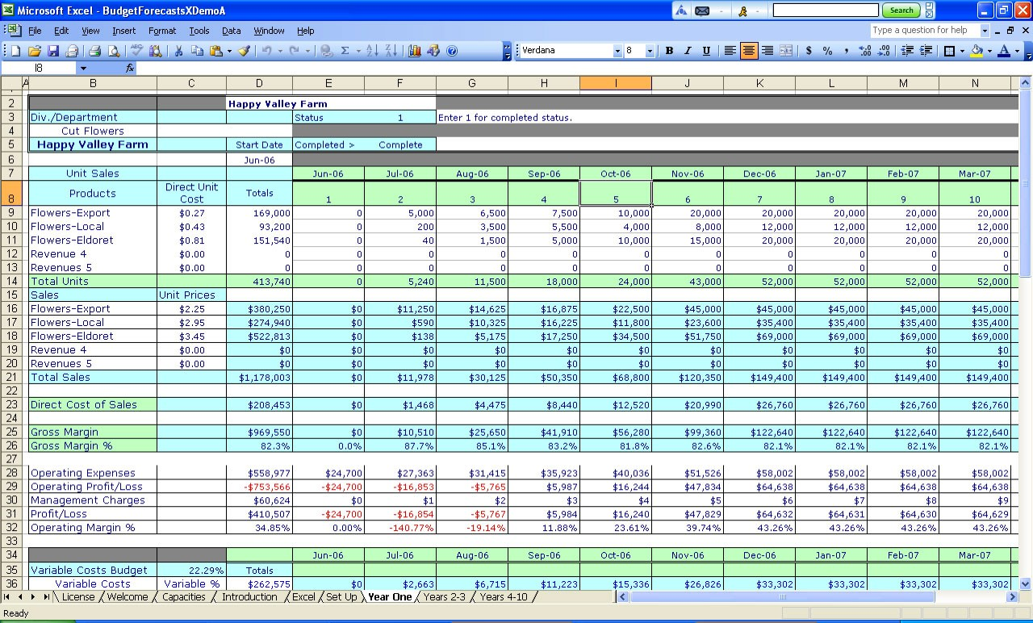
Reactive thinking is not new

Slide 3
The reactive style apps
•
The data is processed as streams
•
Message-driven: notifications
•
Resilient: stay alive in case of failures
•
Data flows through your app’s algorithms
•
Hide complexity of multi-threading
www.reactivemanifesto.org

Slide 4
Java concurrency
•
Blocking I/O is the problem
•
Future.get()
- blocks till all threads are complete
•
CompletableFuture.supplyAsync(task).thenAccept(action)
- what if the tasks need to fetch millions of records?

Slide 5


Some open-source Rx libraries
http://reactivex.io
•
RxJava
•
RxAndroid, RxJavaFX, RxSwing
•
Rx.NET, RxCpp, RxJS, Rx.rb, Rx.py, RxSwift, RxScala, RxPHP
JDK 9 will include reactive streams in java.util.concurrent.Flow

Slide 6
Main RxJava players
•
Observable - producer of data
Observer - consumer of observable sequences Subscriber - connects observer with observable Operator - en-route data transformation Scheduler - multi-threading support
•
•
•
•

Slide 7

An Operator
Observable
Observable
A transforming function

Slide 8
Word | Antonym
Iterable | Observable
Iterator | Observer
Pull | Push

Slide 9

Java 8 Stream: a pull
beers.stream()
.skip(1)
.limit(3)
.filter(b
.map(b ->
-> "USA".equals(b.country))
b.name + ": $" + b.price)
.forEach(beer
-> System.out.println(beer));

Slide 10
A fool with a tool is still a fool
Американская народная мудрость

Slide 11

A fool with a tool is still a fool
Американская народная мудрость
A pull with a tool is still a pull
Yakov Fain

Slide 12

Rx Observable: a push
observableBeer
.skip(1)
.take(3)
.filter(b -> "USA".equals(b.country))
.map(b -> b.name + ": $" + b.price)
.subscribe(
beer err
-> System.out.println(beer),
-> System.out.println(err),
() ->
System.out.println("Streaming
is complete")
);

Slide 13
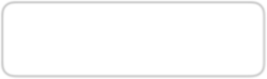





Event-driven push
Subscriber
Observer
push
Subscriber
Observable
push
Observer
push
Subscriber
Observer
Subscribe to messages from Observable and handle them by Observer

Slide 14
Marble Diagrams
http://rxmarbles.com

Slide 15
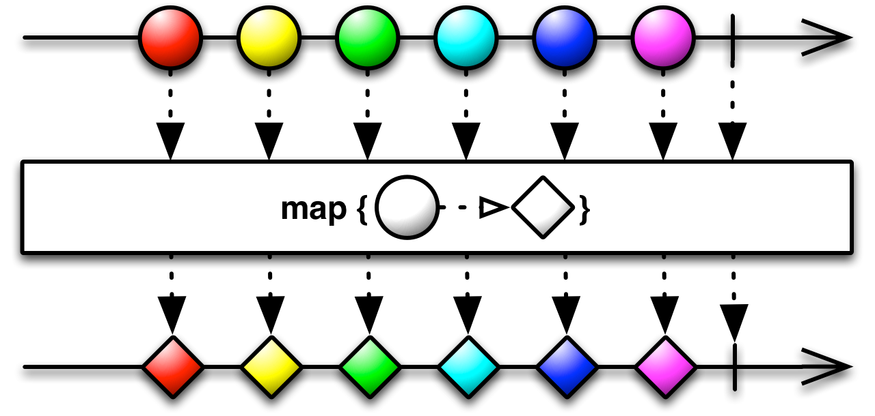
Observable map(function){}

Slide 16
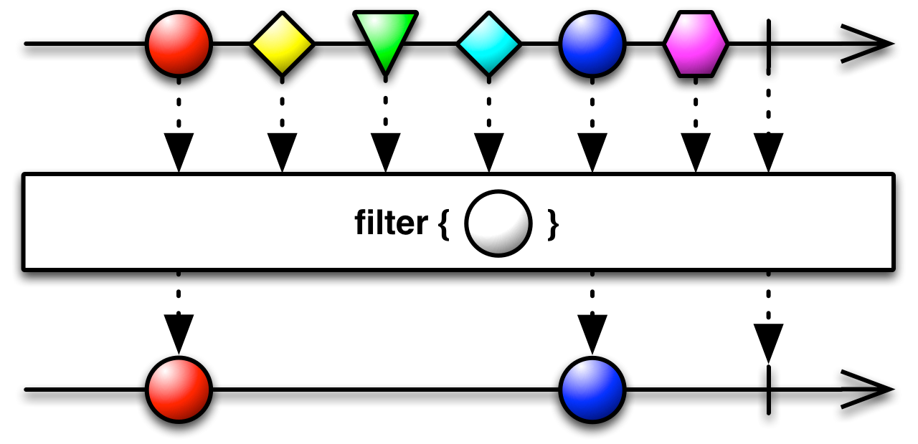
Observable filter(function){}

Slide 17
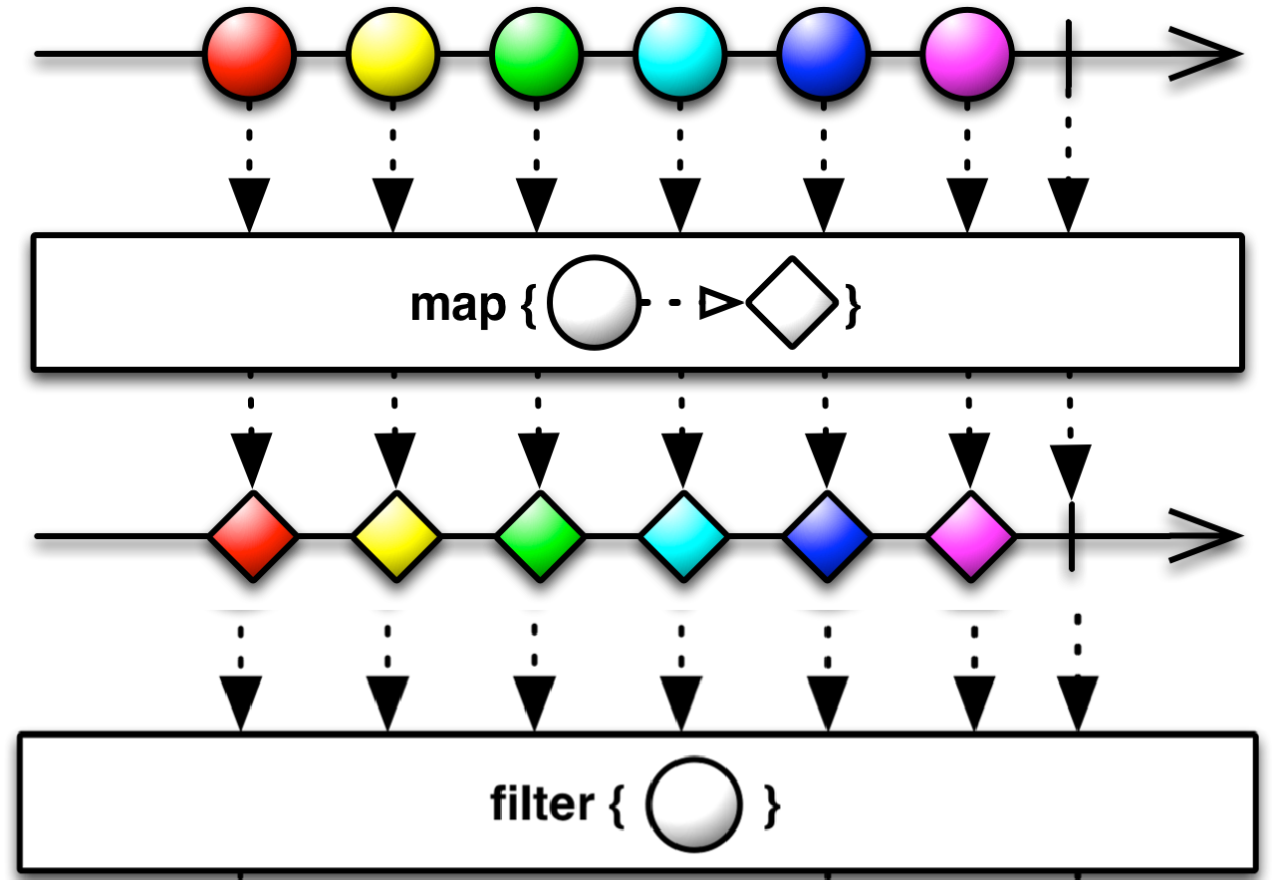






Operator chaining: map and filter

Slide 18
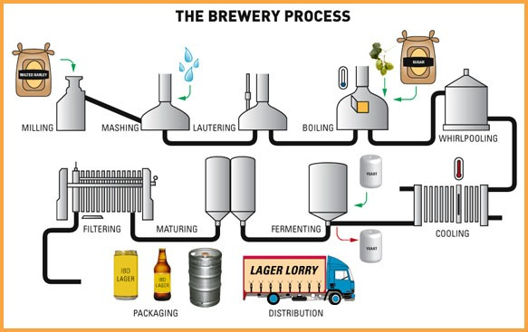
Operator
Operator
Operator
Operator
Observable
Observable
Observable
Observable

Slide 19
Creating an Observable
•
Observable.create() - returns Observable that can invoke methods on Observer
•
Observable.from() -
converts an Iterable or Future into Observable
•
Observable.fromCallable() -
converts a Callable into Observable
•
Observable.empty() - returns empty Observable that invokes onCompleted()
•
Observable.range() - returns a sequence of integers in the specified range
Observable.just() - converts up to 10 items into Observable
•

Slide 20
Demo
BeerClient

Slide 21

Functions with side effects
Affect environment outside the function.
•
doOnNext()
•
doOnError()
•
doOnCompleted()
•
doOnEach()
•
doOnSubscribe()

Slide 22






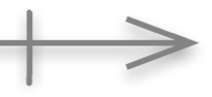
Error Handling
Observer
next error
completed
Observable

Slide 23
Error-handling operators
•
Errors sent using onError() kill the subscription
•
retryWhen() - intercept, anylize the error, resubscribe
•
onErrorResumeNext() - used for failover to another Observable
•
onResumeReturn() - returns an app-specific value

Slide 24
Demo
BeerClientWithFailover

Slide 25
Schedulers

Slide 26
Concurrency with Schedulers
•
An observable stream is single-threaded by default
•
subscribeOn(strategy) - asynchronously subscribes Observers to this Observable on the specified strategy
observeOn(strategy)- modifies an Observable to perform its emissions and notifications on a specified strategy
•

Slide 27




Switching threads
Observable
Operator1()
Operator2()
ObserveOn()
Thread 1
Subscriber
Thread 2

Slide 28
Multi-threading strategies
•
Schedulers.computation() -
for computations: # of threads <= # of cores
•
Schedulers.io() - for long running communications; backed by a thread pool
•
Schedulers.newThread() - new thread fo each unit of work
•
Schedulers.from(Executor) - a wrapper for Java Executor
•
Scedulers.trampoline() - queues the work on the current thread
•
AndroidSchedulers.mainThread() - handle data on the main thread (RxAndroid)

Slide 29
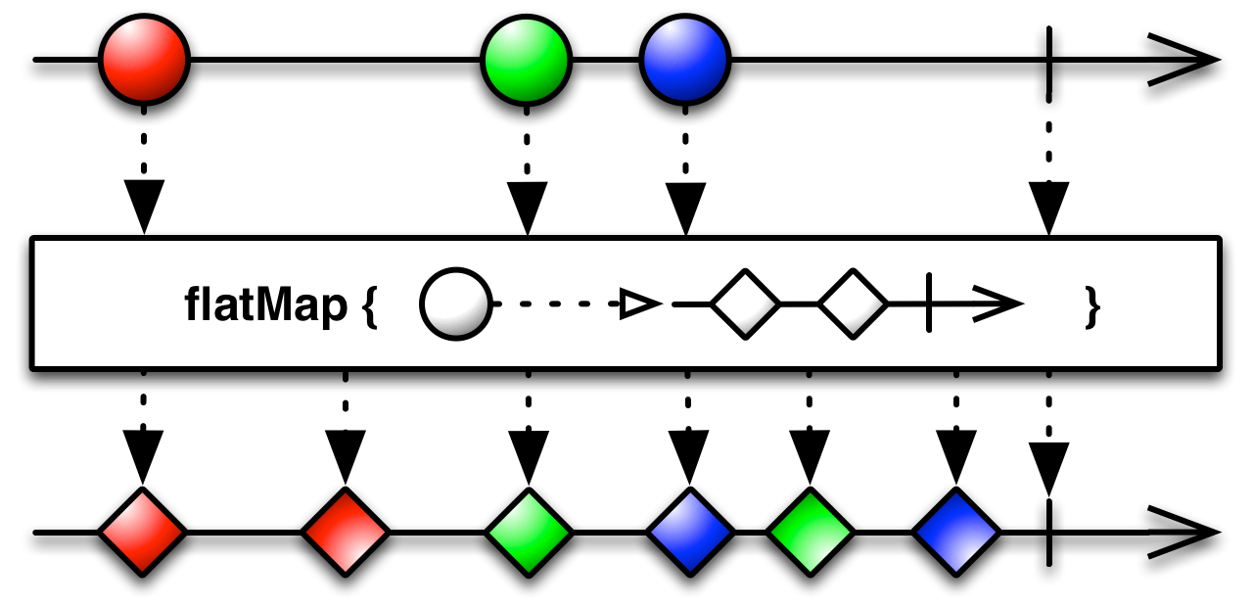
The flatMap() operator

Slide 30





Parallel processing
Observable/Thr2
Subscriber
Observable
Observable/Thr3
Operator1()
Operator2()
flatMap()
Thread 1
Observable/ThrN

Slide 31
Demo
schedulers/SubscribeOnObserveOn schedulers/ParallelStreams

Slide 32


Backpressure
•
Throttling:
sample(), throttleFirst(), debounce()
•
Buffers:
buffer()
•
Window:
window(n)
•
Reactive pull:
Subscriber.request(n)
https://github.com/ReactiveX/RxJava/wiki/Backpressure

Slide 33
Reactivity in action Chat Application

Slide 34

https://goo.gl/qvEnXm

Slide 35
T oolkit
Spring Framework 4
Spring Boot
Spring MVC
Spring Data JPA

Slide 36


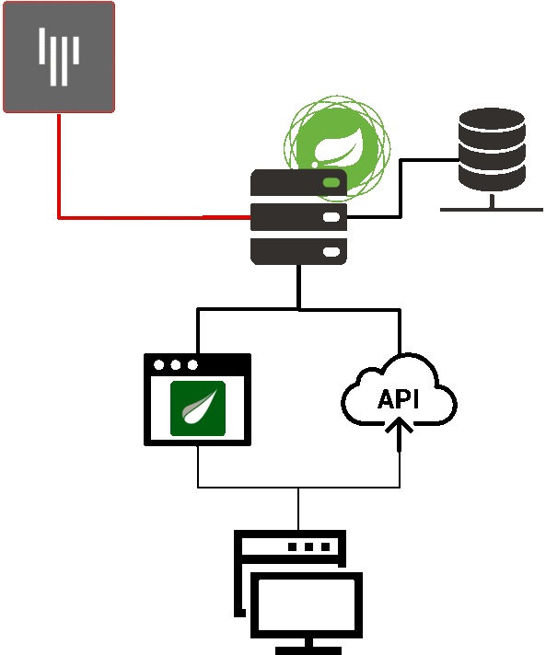
















Service Layer
Gitter Service
DB Layer
Whole Application
Controllers Layer
User Client

Slide 37
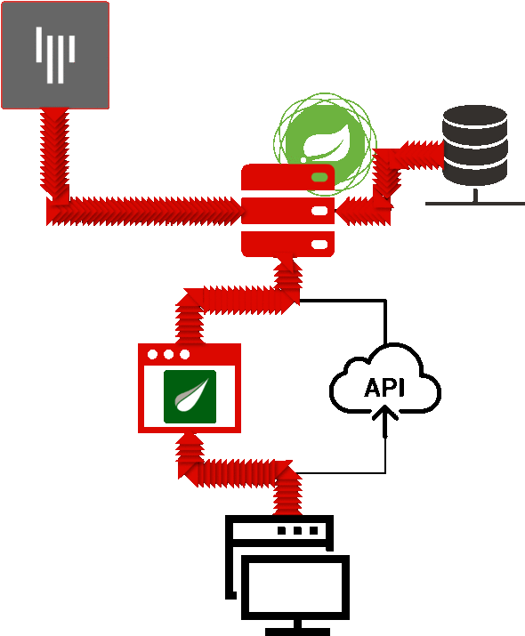

Slide 38
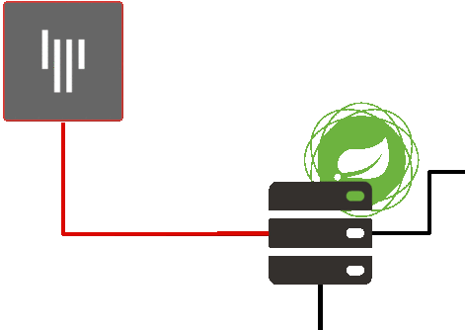
Async Messaging
Push Model

Slide 39
Apply
Streaming API

Slide 40
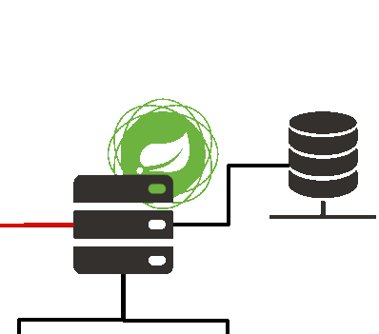
Elasticity
Async Messaging

Slide 41
Dedicate
ThreadPool

Slide 42
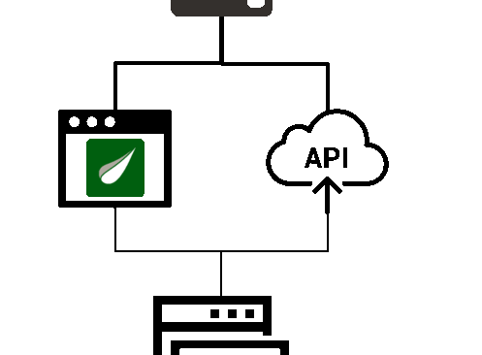
Async Messaging Push Model

Slide 43
Apply WebSocket

Slide 44
How to bring it all together?

Slide 45
Spring 5

Slide 46
WebFlux
@Controller, @RequestMapping,…
Spring MVC
Spring Web Reactive
Servlet API
Reactive HTTP
Servlet Container
Servlet, Netty, Undertow

Slide 47
spring-web
spring-webflux
@RestController
public class UserController {
@GetMapping("/users/{id}")
public User get(long id) { }
@PostMapping("/users/")
public User create(User user) { }
@PutMapping("/users/{id}")
public User update(long id, User user) { }
@DeleteMapping("/users/{id}")
public User delete(long id) { }
}
@RestController
public class UserController {
@GetMapping("/users/{id}")
public Mono<User> get(long id) { }
@PostMapping("/users/")
public Mono<User> create(Mono<User> user) { }
@PutMapping("/users/{id}")
public Mono<User> update(long id, Mono<User> user) { }
@DeleteMapping("/users/{id}")
public Mono<User> delete(long id) { }
}

Slide 48
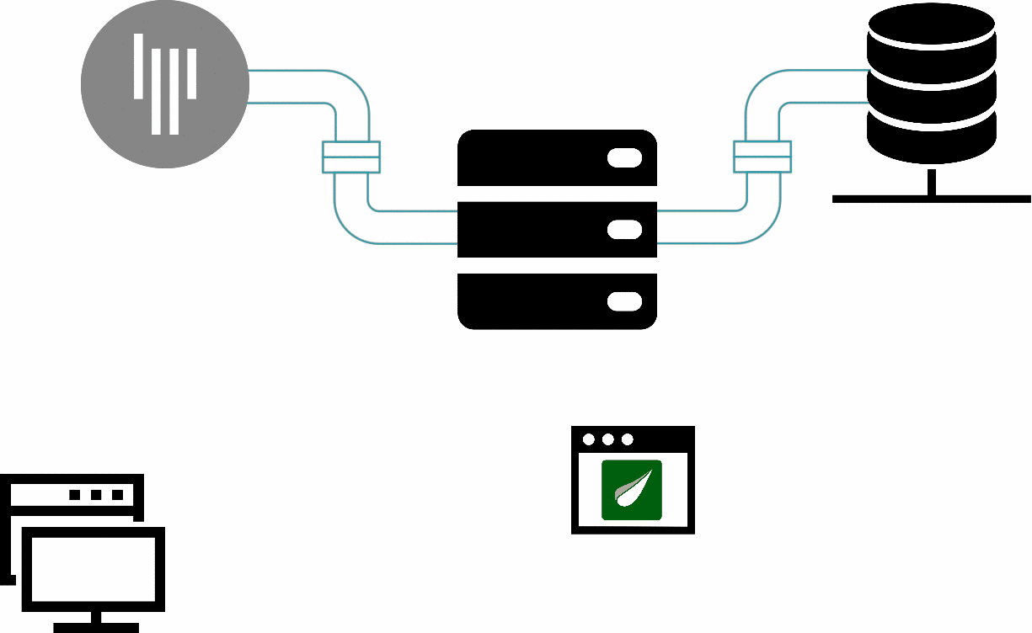


Database Connection Pipe
Message source Pipe
Gitter Connection Pipe
Client Pipe

Slide 49
Thank you!
https://github.com/egor-kiryanov/rxjava
- 1 first part (rxjava examples)
https://github.com/egor-kiryanov/get-reactive-with-spring5-demo
- 2 second part (reactive chat)

